Slide 1
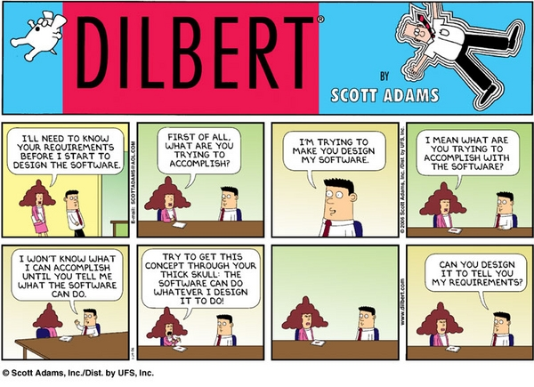

Requirements – “Old School”
Phillips, Ch 5
CSSE579
Session 3
Part 3
Notes:
Dilbert cartoon from http://www.machinediscovery.com/nise/help.html

Slide 2
Requirements you’ll read in SPMH…
Should be interesting to read!
Focus on what you think will be useful to you.
Lots and lots of possible tricks to use –
  It’s like a reference for experts
  We teach whole courses on requirements!
    There’s an art to elicitation, for example.
    And writing them in a form that both stakeholders and developers understand.
    And to managing requirements once you get them.

Slide 3
Step 1: There’s No “Customer”
In traditional IT-style software development, a “Business Analyst” type person writes the requirements.
  See http://thebusyba.com/the-ba-role-is-not-to-gather-requirements/
Customer(s)/ → Business Analyst → Developers
Product Mgr

Slide 4
What points could be useful to you?
Like, picturing all the tricks Phillips describes, in your organization?
  What they would mean there?
  Whether you have an “equivalent” method, or not?
  And which ones to try?
We’ll wait till next week, to ask questions about requirements in the project / presentation.

Slide 5
A few points I suggest are key
“Tense situations”
  When customers are frustrated
  When the problem is bad management
  Managing expectations
Requirements Management: How to keep track of the decisions & make new ones?
How to get to “baselined requirements”?
  Phillips’ “configuration management” of these

Slide 6
Let’s talk techniques
Facilitated Meetings (JAD) – have a big meeting with all the stakeholders, start with a draft, have a bunch of extra people help document it, then turn that into a big requirements doc a few days later
System Storyboarding Technique – write random ideas on sticky notes and stick them on the wall

Slide 7
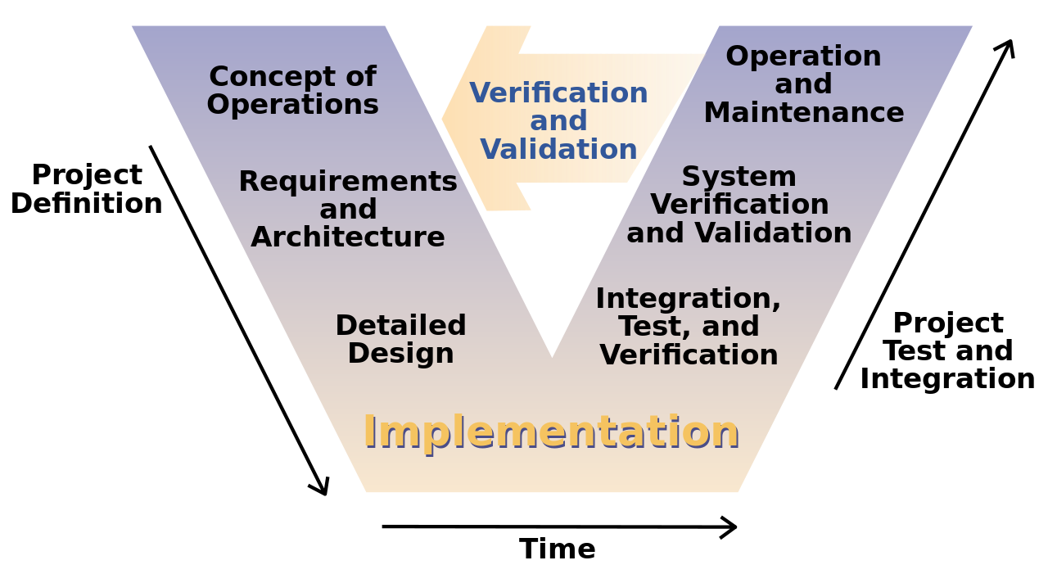
New, or old things?
ConOps – How they “do this” –
  Could be a video that shows detailed operation of the “concept” of the product
Mind Maps – crazy sketch of the various pieces of the product
Gilb Charts – turns qualitative requirements into quantitative ones
All sorts of software diagrams
→ See Phillips pp 270-1 for a good example!
Notes:
Image from http://en.wikipedia.org/wiki/V-Model

Slide 8
Elements of a good document
What is it’s function?
What is the management view?
Who are the readers?
What conventions must it follow
“Avoid creating a document to satisfy a checklist. If a document is not necessary, don’t create one. If it is necessary, it requires diligence from its creators and reviews.”

Slide 9
Characteristics of a good requirements document
Written by the developers or written by the customers?
“What if” requirements
Detailed in the right places, vague in the right places
Verifiable
Understandable by the customer
Traceable
Signed by the stakeholders

Slide 10
Management sidelight - Requirements
The “old school” role was to bridge the gap between customer needs and development activity.
  Getting developers to “do the right stuff”.
  Often, the “business analyst” was in a separate organization.
  Their role was either:
    Perfunctory – doing a translation to system terms, or
    Hugely impacting – writing a whole “spec” that included requirements and architecture, which was taken as scripture by the developers.
      Like a spec written to be developed by a third party, say.

